Slide 1

GOKARAJU RANGARAJU INSTITUTE OF ENGINEERING AND TECHNOLOGY Department of Computer Science and Engineering Real-time Research Project/Societal Related Project
Title of the Proposed Project
Under the esteemed Guidance of
-B. Geetha Kumari
Assistant Professor
Team Members
G. Vishnu Vardhan-22241A050A
A. Revanth- 22241A05Y6
K. Nikhil Reddy- 22241A058A
K. Govardhan- 22241A059A

Slide 2
Contents
Abstract
Literature Survey
Requirements
Proposed System
System Architecture
Design – UML Diagrams
Implementation
Results
Conclusion and Future Scope

Slide 3
Abstract
In today’s competitive job market, a well crafted resume is crucial tool for standing out amidst a sea of applicants.
So, our project ‘Resume Builder Website’ allows user to create a proper resume.
It offers a simple and effective solution for individuals to create impressive resumes tailored to their unique skills, experiences and job preferences.
Our project offers a user-friendly interface from start to finish.
Through a registration and login process, users gain access to homepage where they start creating their resumes.
Users will have the option to select one from available templates.
Next, they will be directed to a form where they can input personal, professional and skill-related information.

Slide 4
It ensures that all essential information is captured accurately and efficiently to provide a perfect resume.
After completing the resume, users can easily download and print it in various formats(pdf, docx) formats according to their requirements.
Our project aims to empower individuals in their job search journey by providing them with the tool needed to create standout resumes.
By combining simplicity, customization and accessibility, our platform equips individuals with the means to make a lasting impression on potential employers in today’s competitive job market.

Slide 5
Literature Survey
S.No. | Title of The Paper & Year | Authors | Methodology & Metrics | Observed Shortcomings/ Gaps in The Paper
1 | Resume Builder Web Application (2023) | Snehal Vijay Patil | Agile/ Scrum, UI/UX principles | Minimal use of AI for keywords
2 | Resume Builder- A Web Application for Creating Resume (2023) | Swapnil, Yukta, Varsha, Harshad, P. A. Chaudari | Grammarly, Firebase, Web Technologies | Very few templates available
3 | Cloud Based Resume Applet | Shugang, Danqing, Zhang | Automatic Updates | Data Security Concerns
4 | Resume Builder System using FSWD (2022) | Sakshi Jadhav, Shreya, Siddhesh | Stack and Web based technologies | No customizable templates
5 | Resume Builder (2022) | Aditya Paliwal Aman Khan Aman Kumawat | Frontend: HTML, CSS Backend: PHP Database: MySQL | Limited options for Customization

Slide 6
Literature Survey
S.No. | Title of The Paper & Year | Authors | Methodology & Metrics | Observed Shortcomings/ Gaps in The Paper
6 | Full Stack Based Application: Online Resume Builder (2022) | Sushant Kumar, Sarthak, Neelendra Shukla | File Storage handled by Firebase | Industry specific limitations
7 | Resume Builder (2022) | Arnav Kumar, Ashu Kumar, Rishab Mishra | Information and Data Retrieval Techniques | Offers only pdf download format
8 | Rezume- A Web Based Resume Builder (2021) | Ayush Arora | Technologies- MONGO DB, Redux, React, etc | Offers only pdf and JSON format
9 | Resume Builder Application (2021) | Shreekant Marapoka | Relevance Ranking Algorithm | Available for only Windows OS
10 | Resume Builder Application (2021) | Rinki Tyagi, Nihal, Akanksha, Ankita | Android SDK, Firebase, etc | Offers only Android Application

Slide 7
Requirements
Software Requirements:
Operating System: Any(Windows, macOS, Linux)
Web Browser : Modern Browser like Chrome ,Brave Or Edge
Hardware Requirements:
Processor: Multi-Core Processor
Memory: 4GB (RAM) or More
Storage: Minimal Storage Requirements
Graphics: Integrated Graphics are Sufficient.

Slide 8
Proposed System
The proposed system aims to address the gaps of previous existing systems. They include:
Customizable Templates: Provides an option regarding to edit and customize templates.
User defined templates: If user already has a template with them, user can upload the template and continue for further resume creation process.
Download formats: provides multiple download formats such as pdf,docx,jpg.
Grammatical Errors: Provide assistance in identifying and resolving grammatical mistakes before downloading the resume.

Slide 9
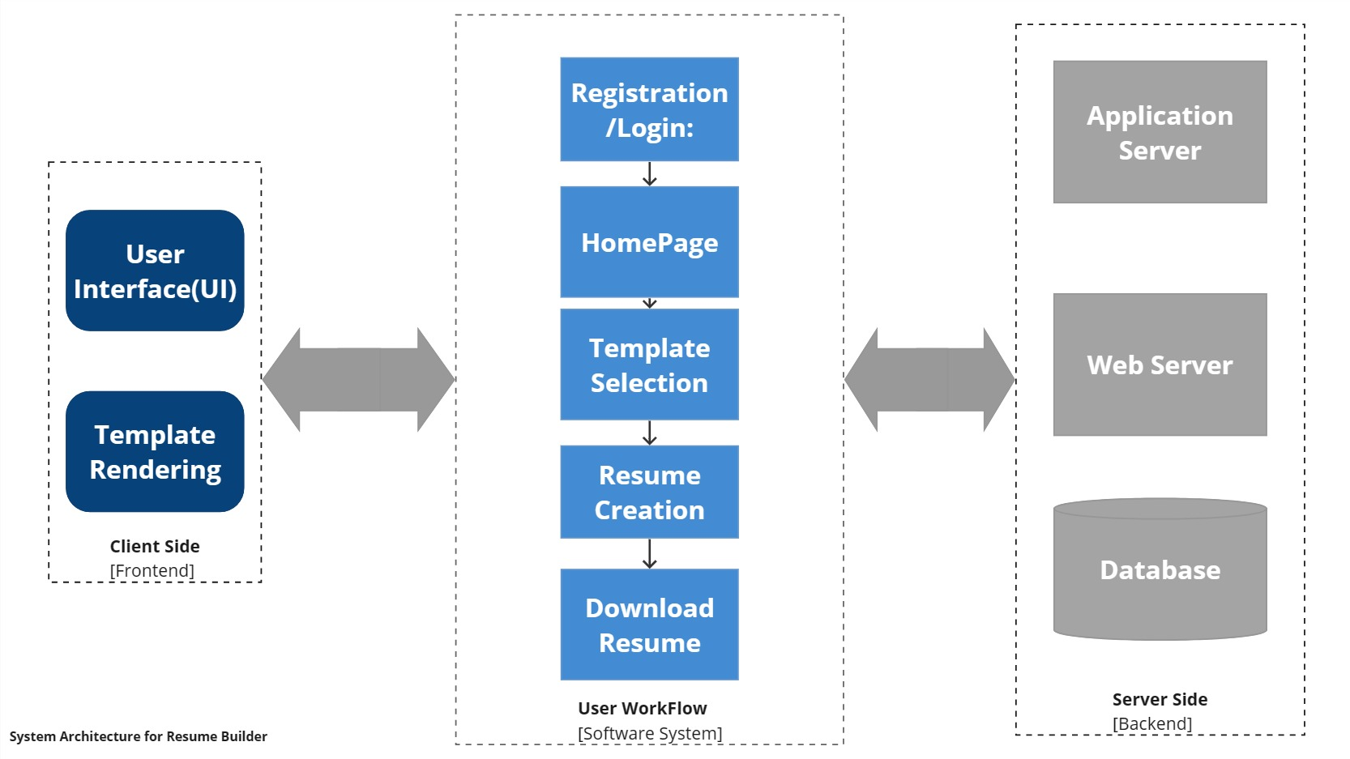
System Architecture

Slide 10
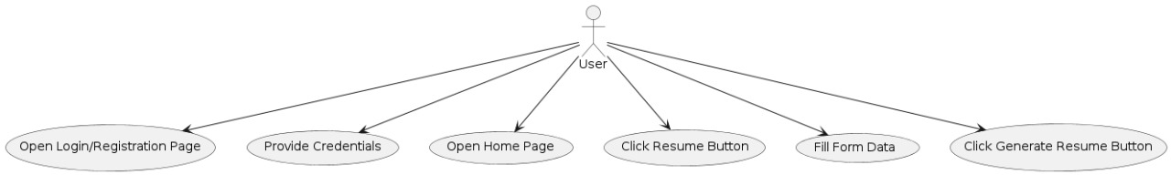
Design – UML Diagrams
Use Case Diagram

Slide 11
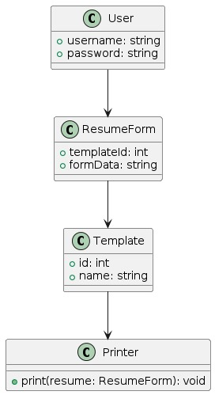
Design – UML Diagrams
Class Diagram

Slide 12
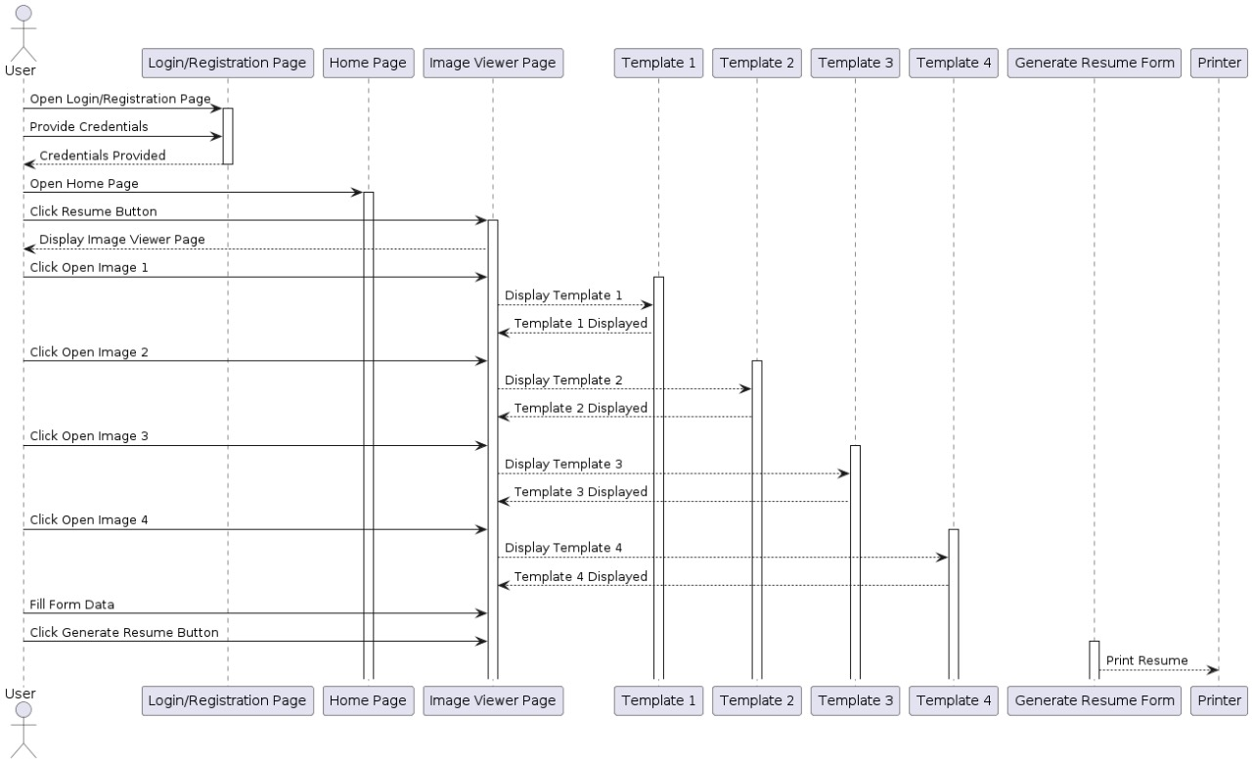
Design – UML Diagrams
Sequence Diagram

Slide 13
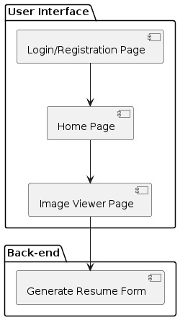
Design – UML Diagrams
Component Diagram

Slide 14
Implementation
Execution of the Project

Slide 15
Results

Slide 16
Conclusion and Future Scope

Slide 17

THANK YOU
Any Queries

